Slide 1


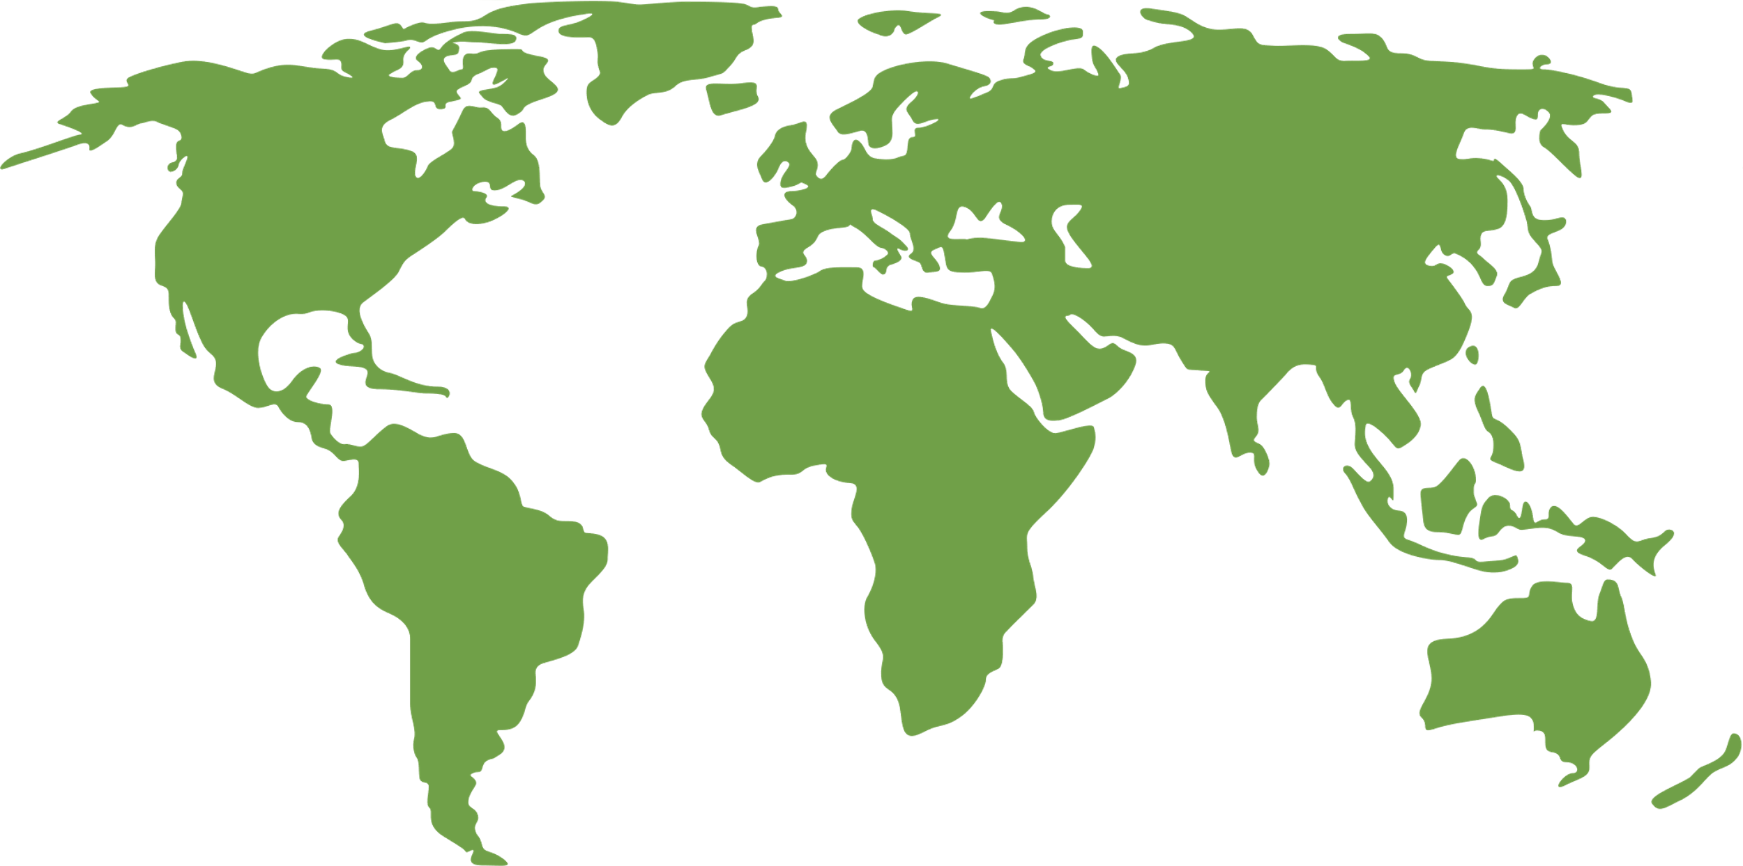
Your Energy Concierge
The problem
Sub Saharan Africa is energy infrastructure deficient due to lack of strategy, planning & investment. This results in energy access barriers
The Solution
The product
DIY – User acquisition of own energy
infrastructure
Digital Experience Platform – solution that customers can use to acquire energy
infrastructure
Generation – Of own energy & storage of such
EAAS – energy as a service, a model with
which users can use energy to service the
acquisitions
Sell – P2P trade of energy to service accrued debt of infrastructure
CRM – framework that allows for deals to be struck through the platform
Market
Business Model
Sub Saharan Market | 32 Countries
B2B2C
13.1 bn
11.1 bn
B2B
B2C
$
$
tam
sam
Partner Network
Network & Customers
7.86 bn
3.93 bn
$
$
som
ems
Location
Financials
Projections based on estimated market share
100 k
1.00 mn
$
$
@ 10 K subscribers
@ 100 K subscribers
where we operate

